Slide 1
Neuromend
By Tempest
An ICT313 Games Technology Project
Ary Bizar, Anopan Kandiah, Hannah Klinac, Alex Mlodawski, Bryan Yu

Slide 2
Introduction
Client: Shri Rai
Supervisor: Fairuz Shiratuddin
Team Name: Tempest
Team Members:
Ary Bizar
Anopan Kandiah
Hannah Klinac
Alex Mlodawski
Bryan Yu
Project Name: Neuromend

Slide 3
Project Management
Methodology
Weekly team/supervisor meetings
Source code control

Slide 4
Background
Stroke
How it affects the brain
Rehabilitation
Rewiring

Slide 5
Problem
Rehabilitation
Expensive
Tedious/boring
Limited

Slide 6
Solution
Virtual Simulation
3 worlds
Devices
Oculus + Keyboard and mouse
Oculus + Razer Hydra
Oculus + Kinect
Oculus + Leap Motion
Sensitivity/Settings
Monitoring progress
Profiles on a database

Slide 7
World (Ary)

Slide 8
Database

Slide 9
Razer Hydra (Bryan)

Slide 10
Kinect (Alex + Anopan)

Slide 11
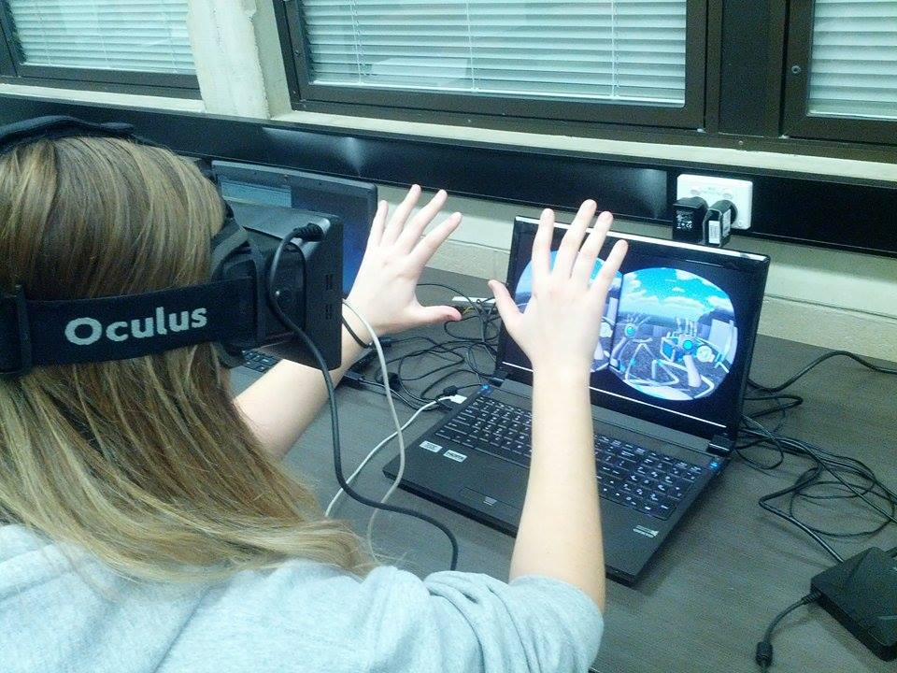
Leap Motion (Hannah)

Slide 12
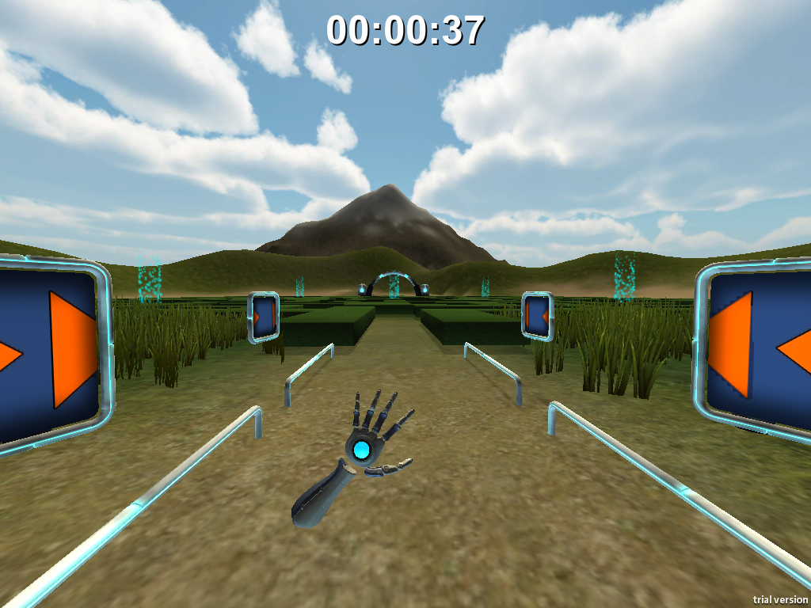
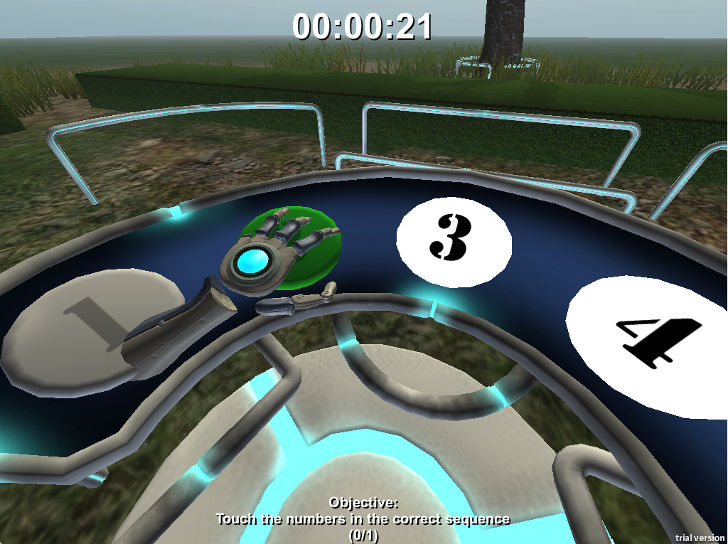
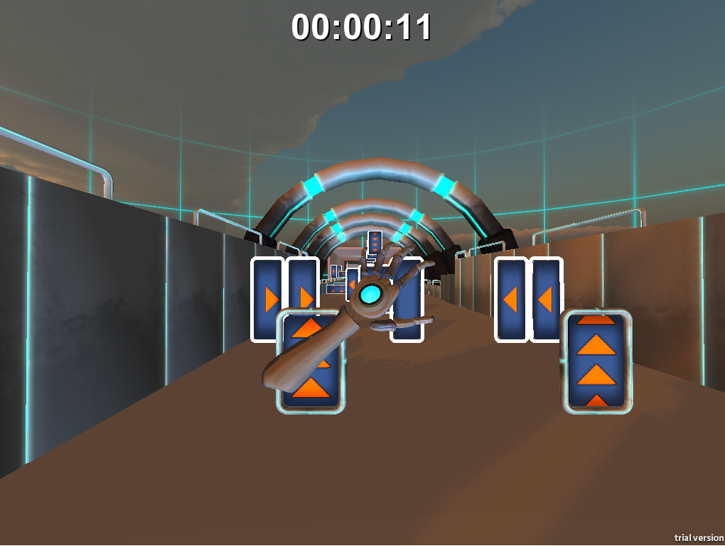
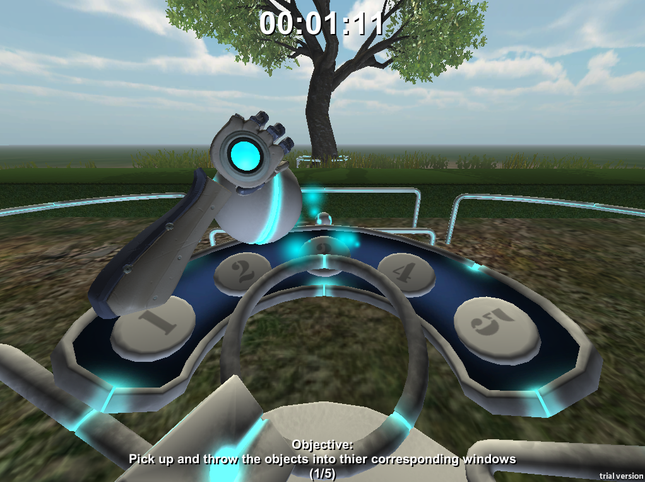
Leap Motion

Slide 13
Current Status
Virtual Simulation
3 levels
Devices
Database
Sensitivity/settings

Slide 14
Future Possibilities
Clinical use
Adding speech

Slide 15
Challenges and Lessons Learned
Devices
Beta products
Driver clashes
Versions/compatability
Designing movements/gestures
Version control (levels + devices)
Communication

Slide 16
Acknowledgements
Client – Mr Shri Rai
Supervisor – Dr Fairuz Shiratuddin

Slide 17
Questions?

